Slide 1
STUDENT ATTENDANCE AND
LEAVE APPROVAL SYSTEM
Database Implementation — Schema, Constraints, Queries & Live Prototype
DBMS PROJECT-BASED LEARNING • REVIEW 2
Presented by
Academic Details
Pranay Kumar Reddy
Roll Number: [25WU0102138]
Class & Section: AIML PANTHERS
Course: Database Management Systems
Guide: [Dr.Kiranmayee Advala]
Department of Computer Science
Review 2 — Working MySQL database and application-ready design
Student Attendance & Leave Approval System | Review 2
1

Slide 2
PROGRESS
From Design to a Working Database
Review 1 completed • Review 2 implementation
Review 1 — Completed
Review 2 — New This Phase
✓ Problem statement, scope & objectives
✓ Users & functional requirements
✓ ER diagram — 5 core entities
✓ Initial relational schema
✓ Database relationships and cardinalities
✓ Schema normalized to 3NF
✓ Full MySQL DDL with PK/FK/CHECK/UNIQUE
✓ 20 students, 15 faculty and academic data
✓ Attendance and leave-request records
✓ Joins, aggregates, subqueries and views
✓ Application-ready database
Student Attendance & Leave Approval System | Review 2
2

Slide 3
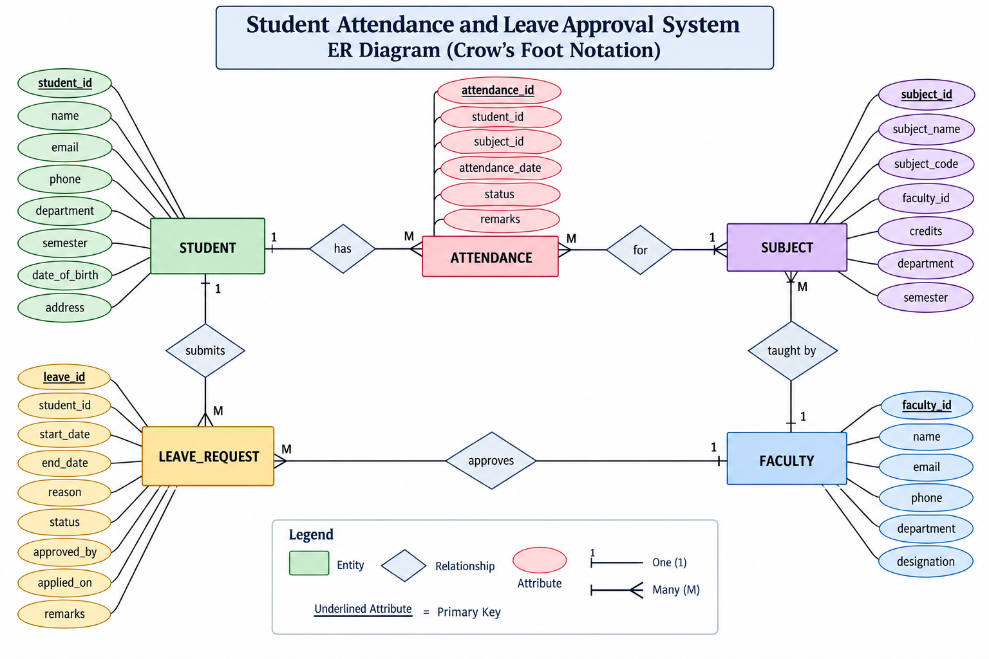
CONCEPTUAL DESIGN
Final Entity-Relationship Model
Crow’s Foot notation
Core Entities
STUDENT • ATTENDANCE • SUBJECT
FACULTY • LEAVE_REQUEST
Key Relationships
Student 1:N Attendance
Subject 1:N Attendance
Faculty 1:N Subject
Student 1:N Leave Request
Faculty 1:N Leave Approval
Model Principle
Primary keys identify records; foreign keys connect entities.
Student Attendance & Leave Approval System | Review 2
3

Slide 4
NORMALIZATION
1NF → 2NF → 3NF, With a Real Example
1NF
2NF
3NF
Every attribute is atomic and repeating groups are avoided.
Each attendance event is stored as one row with one date and one status.
Each project table uses a single-column primary key.
Once 1NF is satisfied, partial dependency is eliminated.
Non-key attributes depend directly on the primary key.
Faculty details are stored once in FACULTY instead of being repeated.
Result: reduced redundancy, improved consistency and clearer foreign-key relationships.
Student Attendance & Leave Approval System | Review 2
4

Slide 5
NORMALIZATION
Key Functional Dependencies
Every determinant is the complete primary key
Student
student_id → name, email, phone, department, semester, date_of_birth, address
Faculty
faculty_id → name, email, phone, department, designation
Subject
subject_id → subject_name, subject_code, faculty_id, credits, department, semester
Attendance
attendance_id → student_id, subject_id, attendance_date, status, remarks
Leave Request
leave_id → student_id, start_date, end_date, reason, status, approved_by, applied_on, remarks
3NF proof: non-key attributes depend on the key, the whole key, and nothing but the key.
Student Attendance & Leave Approval System | Review 2
5

Slide 6
IMPLEMENTATION
Relational Schema — All Core Tables
1
STUDENT(student_id PK, name, email UK, phone, department, semester, date_of_birth, address)
2
FACULTY(faculty_id PK, name, email UK, phone, department, designation)
3
SUBJECT(subject_id PK, subject_name, subject_code UK, faculty_id FK, credits, department, semester)
4
ATTENDANCE(attendance_id PK, student_id FK, subject_id FK, attendance_date, status, remarks)
5
LEAVE_REQUEST(leave_id PK, student_id FK, start_date, end_date, reason, status, approved_by FK, applied_on, remarks)
All foreign-key relationships correspond to the supplied ER diagram.
Student Attendance & Leave Approval System | Review 2
6

Slide 7
DOCUMENTATION
Data Dictionary — Representative Tables
Attendance and leave-request structures
ATTENDANCE
LEAVE_REQUEST
attendance_id | INT | PK | NOT NULL
student_id | INT | FK | NOT NULL
subject_id | INT | FK | NOT NULL
attendance_date | DATE | — | NOT NULL
status | VARCHAR(20) | CHECK | NOT NULL
remarks | VARCHAR(150) | — | NULL
Status: Present / Absent / Late / Excused
leave_id | INT | PK | NOT NULL
student_id | INT | FK | NOT NULL
start_date | DATE | — | NOT NULL
end_date | DATE | CHECK | NOT NULL
reason | VARCHAR(250) | — | NOT NULL
status | VARCHAR(20) | CHECK | NOT NULL
approved_by | INT | FK | NULL
applied_on | DATE | — | NOT NULL
remarks | VARCHAR(250) | — | NULL
Student Attendance & Leave Approval System | Review 2
7

Slide 8
IMPLEMENTATION
DDL & Integrity Constraints
Database rules implemented in MySQL
PRIMARY KEY
FOREIGN KEY
VALIDATION
Unique identifier for every record.
student_id
faculty_id
subject_id
attendance_id
leave_id
Connects related tables.
Attendance → Student + Subject
Subject → Faculty
Leave Request → Student + Faculty
UNIQUE email / subject code
NOT NULL required fields
CHECK semester / credits
CHECK attendance / leave status
CHECK end_date ≥ start_date
Integrity constraints prevent invalid and inconsistent academic records.
Student Attendance & Leave Approval System | Review 2
8

Slide 9
IMPLEMENTATION
Realistic Sample Data Loaded
Populated database for demonstration
20
15
15
30
20
Students
Faculty
Subjects
Attendance
Leave Requests
Student Dataset
Faculty Dataset
20 named students, including Pranay Kumar Reddy and the other supplied project records.
15 faculty records used for subject teaching and leave approval.
The populated dataset supports realistic attendance and approval scenarios.
Student Attendance & Leave Approval System | Review 2
9

Slide 10
QUERYING THE DATABASE
Queries, Aggregation & Views
Examples for the working database
JOINs
Aggregation
Views & Subqueries
Student + Attendance + Subject
Leave Request + Student + Faculty
Faculty + Subject
Purpose: combine normalized data into reports.
COUNT attendance records
SUM Present / Absent
GROUP BY student
HAVING attendance < 75%
Purpose: attendance analytics.
Pending leave view
Attendance summary
Students below threshold
Average-based analysis
Purpose: reusable reporting.
Student Attendance & Leave Approval System | Review 2
10

Slide 11
DATA INTEGRITY
Business Rules — Tested & Confirmed
Rules enforced by the database
Attendance status
Present / Absent / Late / Excused
CHECK
Leave status
Pending / Approved / Rejected
CHECK
Leave dates
end_date ≥ start_date
CHECK
Email
Student and faculty emails unique
UNIQUE
Subject code
Each subject code unique
UNIQUE
References
Invalid IDs rejected
FOREIGN KEY
These rules make the database reliable before the application layer is added.
Student Attendance & Leave Approval System | Review 2
11

Slide 12
LIVE PROTOTYPE
Live Database Prototype
Demo flow for Review 2
Student
MySQL
Faculty
Reports
View attendance
Apply leave
→
Tables
PK / FK / constraints
→
Review leave
Approve / Reject
→
Attendance
Leave status
Achieved
A normalized, constraint-enforced MySQL database with populated student/faculty data, attendance tracking and leave approval workflow — ready for the application layer.
Thank You — Questions & Discussion
Student Attendance & Leave Approval System | Review 2
12

